Slide 1
Regulatory Framework and Resources to Enhance Protection of Older and Vulnerable Clients
Investor Office
Paola Cifelli, Manager, Policy and Initiatives
Michael Tracey, Manager, Investor Research and Behavioural Insights
Jennifer Lee-Michaels, Senior Advisor, Policy
Danica Sergison, Advisor, Policy
October 5, 2021

Slide 2
Disclaimer
The views expressed in this presentation are the personal views of the presenting staff and do not necessarily represent the views of the Ontario Securities Commission or any of its other staff.
The presentation is provided for general information purposes only and does not constitute legal advice.
Information has been summarized and paraphrased for presentation purposes and the examples have been provided for illustration purposes only. Information in this presentation reflects securities legislation and other relevant standards that are in effect as of the date of the presentation.
The contents of this presentation should not be modified without the express written permission of the presenters.

Slide 3
Background
1
2
Regulatory Framework
Trusted Contact Person
Temporary Hold
3
Protecting Aging Investors through Behavioural Insights
4
White Label Resources

Slide 4
Background What we set out to address
Canadians are living longer, and older Canadians are increasingly making up a greater proportion of the population.
Older investors are at heightened risk of losing money due to fraud and financial exploitation. Diminished mental capacity also has the potential to endanger financial security.
The client relationship positions registrants well to detect signs of financial exploitation, vulnerability, or diminished mental capacity.
Investors, investor advocates, registrants and industry associations have long expressed support for a regulatory framework that enhances protection of older and vulnerable investors and helps registrants address issues of financial exploitation and diminished mental capacity facing their clients.

Slide 5
Background
The OSC Seniors Strategy, published in March 2018, reinforces the OSC's vision of a stronger and more secure financial future for all Ontario seniors.
The regulatory framework we designed is a key element of the Strategy.
CSA Staff Notice 31-354 Suggested Practices for Engaging with Older or Vulnerable Clients was published in June 2019.
In March 2020, we published for comment proposed amendments to NI 31-103 and its Companion Policy designed to outline how registrants can address situations involving diminished mental capacity or the potential financial exploitation of their clients.
After considering the comments, the CSA published the amendments in final form on July 15, 2021.

Slide 6
Background
1
2
Regulatory Framework
Trusted Contact Person
Temporary Hold
3
Protecting Aging Investors through Behavioural Insights
4
White Label Resources

Slide 7
Regulatory Framework
Supported by new definitions, the amendments provide registrants with tools to address issues of financial exploitation and diminished mental capacity facing their clients:
Trusted Contact Person (TCP)
The amendments require registrants to take reasonable steps to obtain and keep current the name and contact information of a client’s TCP and the client’s consent to contact the TCP in certain circumstances.
Temporary Holds
The amendments create a framework for registrants that place a temporary hold on transactions, withdrawals or transfers in circumstances where the registered firm has a reasonable belief that there is financial exploitation of a vulnerable client or that the client lacks the mental capacity to make decisions involving financial matters.

Slide 8
Background
1
2
Regulatory Framework
Trusted Contact Person
Temporary Hold
3
Protecting Aging Investors through Behavioural Insights
4
White Label Resources

Slide 9
What is the role of a TCP?
A TCP is a resource for registrants to contact to assist in protecting a client’s financial interests or assets when responding to circumstances of possible financial exploitation or concerns about a client’s mental capacity.
A registrant can also contact a TCP to confirm the client’s contact information or to make inquiries about the name and contact information of a legal representative of the client.
Clients should be encouraged to name as their TCP an individual who they trust, is mature and has the ability to communicate and engage in potentially difficult conversations with the registrant about the client’s personal situation.
Unlike an attorney under a power of attorney, a TCP does not have the authority to transact on the client’s account or to make any other decision on behalf of the client.

Slide 10
Is there a prescribed form for collecting and updating TCP information?
No. Registrants may wish to develop a stand-alone form or incorporate the information into an existing form that includes:
the circumstances in which the registrant may contact the TCP,
space to document information about the TCP, including their name, mailing address, telephone number, email address and nature of the relationship with the client,
a signature box for the client to provide their consent to contact the TCP,
a statement that confirms the client’s right to withdraw consent to contact the TCP, and
a description of how to change TCP information.
Registrants are expected to update the TCP information as part of the process to update KYC information.

Slide 11
What if a client refuses to provide TCP information?
Registrants may open and maintain a client account if the client refuses or fails to identify a TCP; however, registrants must still take reasonable steps to obtain TCP information as part of the KYC process.
Examples of reasonable steps include explaining to the client the purpose of a TCP, providing the client with the disclosure required by s. 14.2(2)(l.1), and asking the client to provide the name and contact information of a TCP.
At each KYC update, clients who had previously refused to provide TCP information should be asked if they would now like to provide the information.
Firms are reminded of the requirements to maintain records, document correspondence with clients, and document compliance, training and supervision actions taken by the firm.

Slide 12
Background
1
2
Regulatory Framework
Trusted Contact Person
Temporary Hold
3
Protecting Aging Investors through Behavioural Insights
4
White Label Resources

Slide 13
Temporary Holds
A “temporary hold” is a hold that is placed on a securities transaction or a disbursement from a client’s account.
It is a tool that can be used to protect clients and their assets where a firm reasonably believes that a vulnerable client is experiencing financial exploitation or that a client lacks mental capacity to make financial decisions.
Decisions to place temporary holds should be made by the CCO or authorized supervisory, compliance or legal staff.
When placing temporary holds in accordance with s. 13.19, registered firms and their registered individuals must act in a manner that is consistent with their obligation to deal fairly, honestly and in good faith with their clients.

Slide 14
Temporary Holds
A temporary hold is not intended to be a hold on the entire client account, but rather, over a specific purchase or sale of a security or withdrawal or transfer of cash or securities from a client’s account.
Transactions unrelated to the suspected financial exploitation or lack of mental capacity should not be subject to the temporary hold.
If the transaction, withdrawal or transfer involves all the assets in the account, it may be reasonable to place a temporary hold on the entire account while not limiting the payment of regular expenses.

Slide 15
Conditions for Temporary Hold
If a registered firm or individual places a temporary hold under s. 13.19, the firm must do all of the following:
document the facts and reasons that caused the firm or individual to place and, if applicable, to continue the temporary hold;
provide notice of the temporary hold and the reasons for the temporary hold to the client as soon as possible after placing the temporary hold;
review the relevant facts as soon as possible after placing the temporary hold, and on a reasonably frequent basis, to determine if continuing the hold is appropriate;
within 30 days of placing the temporary hold and, until the hold is revoked, within every subsequent 30-day period, either revoke the temporary hold, or provide the client with notice of the firm’s decision to continue the hold and the reasons for that decision.

Slide 16
TCP and Temporary Holds
While there is no requirement for firms to contact a TCP prior to placing a temporary hold, firms may wish to contact a TCP.
Where a temporary hold will be placed based on a firm’s reasonable belief that a vulnerable client is experiencing financial exploitation, then before contacting the TCP, the firm should assess whether there is a risk that the TCP is a perpetrator of the exploitation.
For clarity, the fact that a client has not named a TCP does not preclude a registrant from placing a temporary hold.

Slide 17
Policies and Procedures
Registered firms should have written policies and procedures that address TCP and temporary hold requirements, including:
how to collect and document TCP information and keep it up-to-date,
how to obtain the written consent of a client to contact their TCP, how to document any restrictions on contacting the TCP and what type of information can be shared,
circumstances where a decision to contact a TCP must be escalated for review, and how to document this review,
detailed warning signs of financial exploitation of a vulnerable client, and signs of a lack of mental capacity of a client to make decisions involving financial matters, and
delineation of firm and individual responsibilities for addressing concerns of financial exploitation of a vulnerable client or a lack of mental capacity of a client.

Slide 18
Transition
The amendments will take effect at the same time as the KYC provisions of the Client Focused Reforms (i.e., December 31, 2021).
In respect of existing clients, the expectation is that registrants will take reasonable steps to collect TCP information from those clients the first time they update the client’s KYC information after December 31, 2021.

Slide 19
Background
1
2
Regulatory Framework
Trusted Contact Person
Temporary Hold
3
Protecting Aging Investors through Behavioural Insights
4
White Label Resources

Slide 20
OSC Staff Notice 11-790 Protecting Aging Investors through Behavioural Insights
We demonstrate how behavioural insights can be used to increase the likelihood that your clients choose to appoint a trusted contact person by 23%.

Slide 21
Economic Rationality
The rational agent:
Has and understands all necessary information.
Knows the probabilities of events.
Determines preferences based on costs and benefits.
Consistently chooses the self-determined best choice of action.

Slide 22
Rationality and the TCP
Investor with salary of $75,000 and $1,000,000 in assets
Risk of vulnerability-based loss: 0.00005%
Time to Provide TCP: 10 minutes.

Slide 23
Rationality and the TCP
Bounded Rationality:
Decision Making Heuristics:
Cognitive Biases:

Slide 24
Bias vs Error
Error: Random BIAS: Predictable

Slide 25
Project Goals
The OSC believes that appointing a TCP could help protect older investors from financial exploitation and the negative effects of diminished mental capacity.
The measures of success for this project were:
Increase uptake rate
Increase objective comprehension of the TCP role
Increase willingness to appoint a TCP
Increase perceived value
Reduce cognitive biases

Slide 26
TCP Decision Map
1. Comprehension
2. Evaluation
3. Taking Action
Investors need to understand the decision.
Challenge:
Financial literacy is necessary to comprehend the decision.
Investors need to evaluate the utility and risks of the decision.
Challenge:
Misconceptions, biases, and perceptions determine how seniors evaluate their choices
Investors need to follow through on their decision.
Challenge: Intention to act is not the same as acting.
1
2
3
COMPREHENSION
25

Slide 27
Biased Decision-Making
Optimism Bias – The tendency for people to underestimate the likelihood of negative events.
Choice Supportive Bias – The tendency for people to ascribe positive attributes to a choice that was made in the past.
Illusory Superiority – People overestimate their qualities, in relation to the same qualities of other people.
Illusion of Control– The tendency for people to overestimate their ability to control events.

Slide 28
Behavioural Interventions
Priming: Exposure to a stimulus influences subsequent decisions.
Active Choice: Forcing people to choose increases the salience of their decision.
Social Norms: People tend to follow the expectations of others in their group.
Boosts: Promote individual capabilities to make more informed choices.

Slide 29
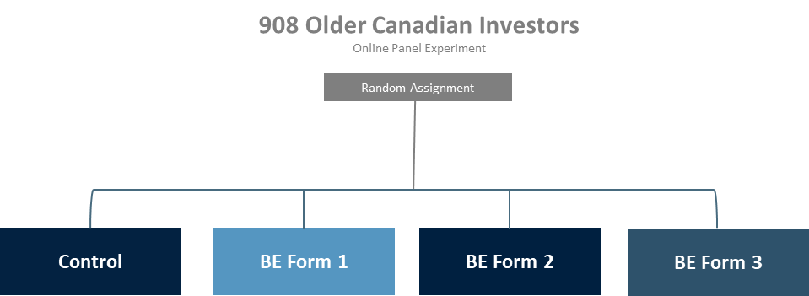
Experimental Design

Slide 30
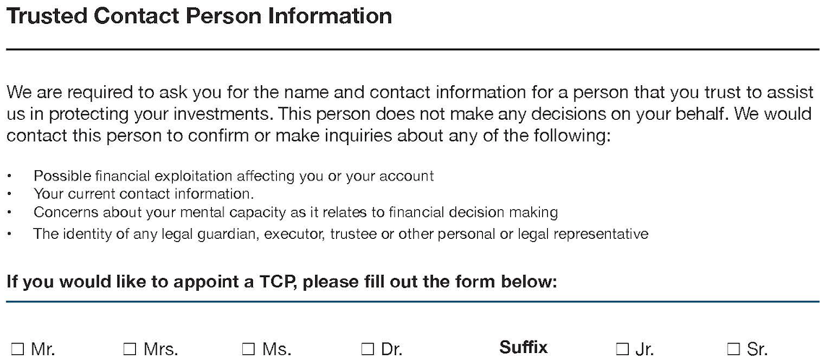
Control Form

Slide 31
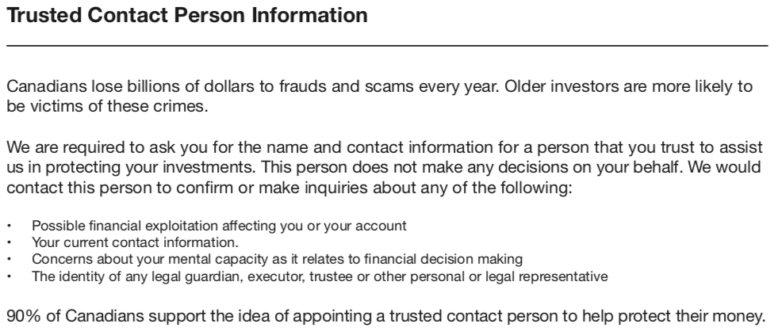
Control Form

Slide 32
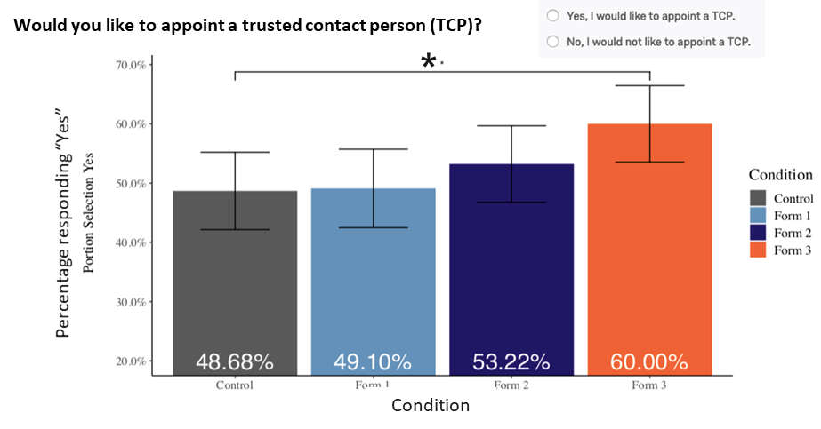
Experimental Results

Slide 33
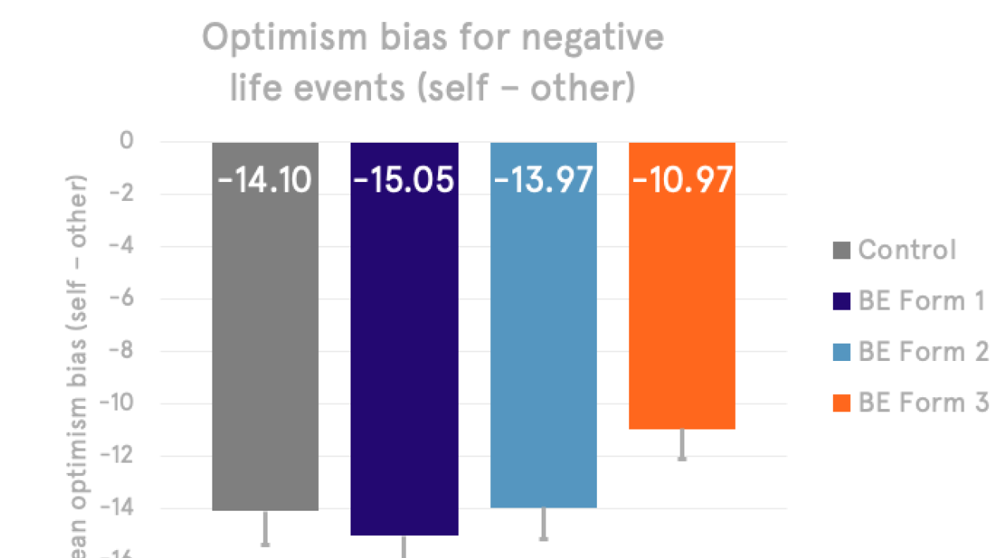
Experimental Results

Slide 34
Evidence-Based Recommendations
Describe the role of the TCP in plain language.
A statement intending to boost decision making by informing about the risks associated with investing.
A statement providing a social reference for the acceptance of the role of the TCP.
Active choice format for appointing a TCP.

Slide 35
Background
1
2
Regulatory Framework
Trusted Contact Person
Temporary Hold
3
Protecting Aging Investors through Behavioural Insights
4
White Label Resources

Slide 36
White Label Materials
Enhanced education and outreach activities, including through tools and resources, are a key element of the Seniors Strategy.
A series of 2-3 page leaflets that firms can adapt, brand and distribute to their representatives, covering topics such as working respectfully with older and vulnerable clients and identifying and responding to signs of financial exploitation or diminished mental capacity.
A leaflet will also be included for clients to complete and provide to the individual they name as TCP, providing your representative’s information and information about TCPs.
Intended to be an accessible, optional resource that firms may modify and provide for their representatives to use when they encounter issues that arise with older and vulnerable clients.

Slide 37
White Label Materials
The leaflets will include practical tips and content from prior publications, such as the OSC Seniors Strategy, CSA Staff Notice 31-354 Suggested Practices for Engaging with Older or Vulnerable Clients, and OSC Staff Notice 11-790 Protecting Aging Investors through Behavioural Insights.
The white label materials will not replace a firm’s policies, procedures or documentation. Where the materials touch on regulatory requirements, they will summarize the registered representative’s role and direct them to the firm’s policies for more information.
Firms that elect to use the white label materials as a resource must adapt them in a manner that aligns with their own policies, procedures and interpretations of their regulatory obligations.

Slide 38
References
OSC Staff Notice 11-779 Seniors Strategy
CSA Staff Notice 31-354 Suggested Practices for Engaging with Older or Vulnerable Clients
OSC Staff Notice 11-790 Protecting Aging Investors through Behavioural Insights
CSA Notice of Amendments to NI 31-103 and to 31-103CP to Enhance Protection of Older and Vulnerable Clients

Slide 39
Questions

